Slide 1
Week 3 - Arrays
Microsoft Interview Coaching Program

Slide 2
Agenda
Homework submission guidelines
TEBOW IT review for last week’s homework assignment (Longest Substring Without Repeating Characters)
Arrays!
Classroom problem: Two Sum
Homework problem

Slide 3
TEBOW IT your homeworks!
TEBOW IT your homework problem on paper/whiteboard
This is *exactly* what you will do in your real interviews
Time yourself to 45 min – so you know which step of TEBOW IT needs more practice
Save your work so far via pictures (Let’s call it paperwork)
Code your solution on your computer
Helps you understand any missed gaps in your solution (gaps should reduce with practice!)
Helps in sharing your code with your coaches through pull requests
You will follow TDD here as well - write unit tests first and then code
Submissions:
1. Pull request with your unit tests and code
2. Paperwork (you can attach it to your pull request)

Slide 4
Announcements
Students who fail to submit more than TWO homework assignments will be dropped from the program
Tag your coach in slack channel when you submit your pull request (use @CoachName)

Slide 5
TEBOW IT – Longest Substring Without Repeating Characters

Slide 6
Longest Substring Without Repeating Characters
Given a string, find the length of the longest substring without repeating characters
Examples:
Given "abcabcbb", the longest substring is "abc", so the answer is 3.
Given "bbbbb", the longest substring is “b", so the answer is 1.
Given "pwwkew", the longest substring is “wke", so the answer is 3. Note that the answer must be a substring, "pwke" is a subsequence and not a substring.

Slide 7
T – Talk (/Listen/Clarify)
Get a clarification of substring or subsequence if not mentioned in the question
What is the expected output? The longest substring without repeating chars or its length?
Are the inputs case sensitive? Is ‘aA’ and ‘aa’ the same or distinct?
Are spaces allowed in the input? If yes, do we ignore them? If no, then is it bad input?
How do you handle bad input?

Slide 8
E – Examples (/Test/TDD)
Sample Input | Equivalence Class | Output
Null input | Null input | 0 / -1 / null / throw exception (Discuss with interviewer)
“” | Empty string | 0
“a” | Input with single character | 1
“pwwkew” | Input with more than one character | 3 (wke)
“abcdefg” | No repeating characters in input | Length of input - 7
“aaa” | Single repeating character | 1
“aA” | Case sensitivity | If case sensitive, then 2 If not case sensitive, then 1

Slide 9
E (cont.) – out of the box testing
Sample Input | Equivalence Class | Output
“abcabcabc” | Same substring appears twice | 3
“abcabcd” | Same substring appears twice, second time progresses into longer substring with no repeating characters | 4

Slide 10
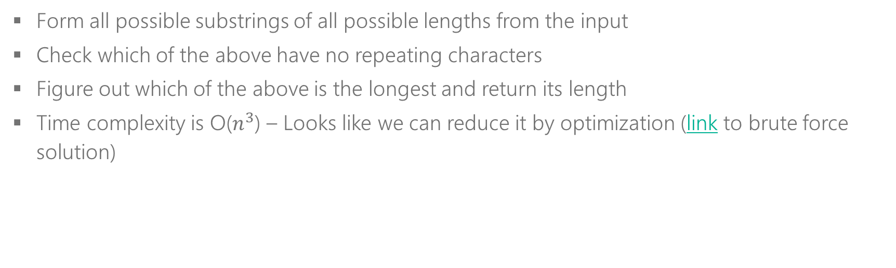
B – Brute Force
Form all possible substrings of all possible lengths from the input
Check which of the above have no repeating characters
Figure out which of the above is the longest and return its length
Time complexity is O($n^{3}$) – Looks like we can reduce it by optimization (link to brute force solution)

Slide 11
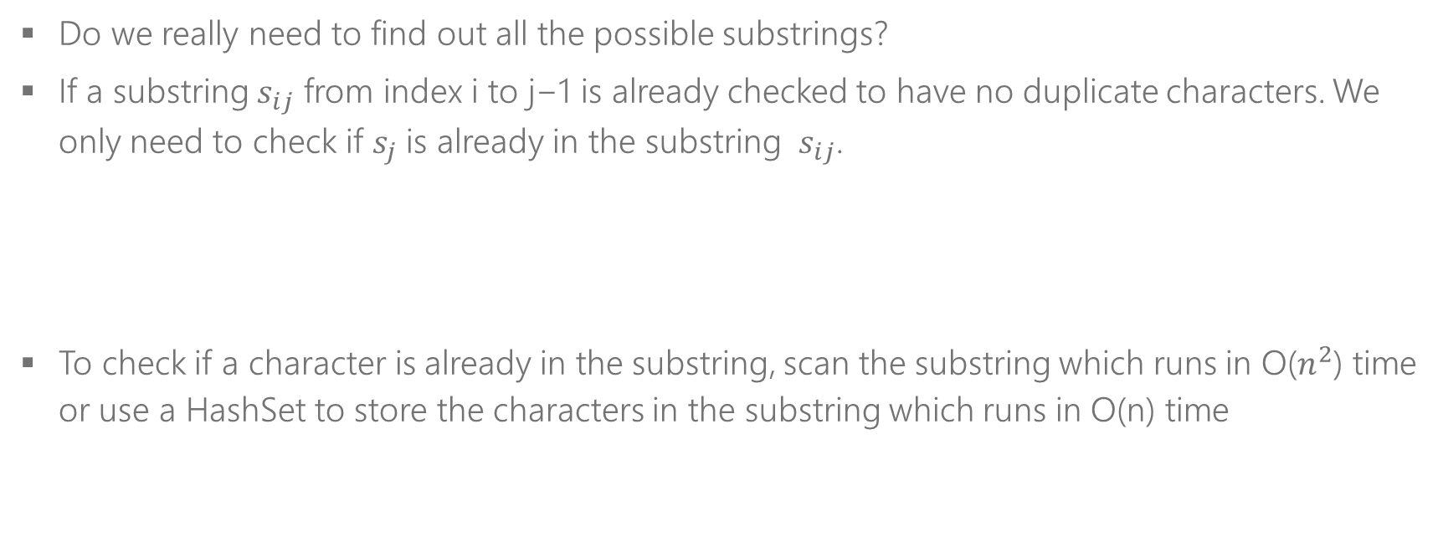
O - Optimize
Do we really need to find out all the possible substrings?
If a substring $s_{ij}$​ from index i to j−1 is already checked to have no duplicate characters. We only need to check if $s_{j}$is already in the substring $s_{ij}$.
To check if a character is already in the substring, scan the substring which runs in O($n^{2}$​​) time or use a HashSet to store the characters in the substring which runs in O(n) time
i
j-1
j
p
w
w
k
e
w

Slide 12
O - Optimize
Window
A window is a range of elements in the array/string which usually defined by the start and end indices.
[i, j) left-closed and right-open
Sliding Window
A sliding window is a window that "slides" its two boundaries in left and/or right directions. For example, if we slide [i, j) to the right by 1 element, then it becomes [i+1, j+1) (left-closed, right-open).
i+1
j+1
i
j
p
w
w
k
e
w

Slide 13
O - Optimize
i
j
i
j
a
b
c
d
e
f
g
a
b
c
d
e
f
g

Slide 14
O - Optimize
i
j
i
j
a
b
c
d
b
f
g
a
b
c
d
b
f
g

Slide 15
W – Walk Through
Input Validation
Always check if the input is null – if yes, return appropriate result, if not proceed.
Create helper data structures
Slide window - left to right
Return
Create and initialize the HashSet that represents the sliding window
Create and initialize the start and end indices that represent the sliding window boundaries. Initially the window is (0,0]
Create and initialize variables needed to store the result, etc.
Examine input[j] character
If it is NOT part of the existing window, expand the window to the right and calculate the new max length
If it is part of the existing window, expand the window to the right, but also, contract the window from left until duplicate of input[j] is dropped
Continue this until we have examined all characters i.e. right boundary of window hits the end of string
Return the maximum length encountered so far

Slide 16
I - Implement
public static int GetLSWRCLength(string s)
{
if (s == null)
return 0;
int n = s.Length;
HashSet<char> set = new HashSet<char>();
int ans = 0, i = 0, j = 0;
while (i < n && j < n)
{
if (!set.Contains(s[j]))
{
set.Add(s[j]);
j++;
ans = Math.Max(ans, j - i);
}
else
{
set.Remove(s[i]);
i++;
}
}
return ans;
}

Slide 17
T - Test
Does this work for null Strings?
Does this work for empty Strings?
Run through an example from ‘input with single character’ class
Run through an example from ‘input with multiple characters’ class
Run through an example from ‘input with no repeating characters’ class
Run through an example from ‘input with single repeating characters’ class
Run through an example based on your case sensitivity decision
Run through an example from ‘same substring appears twice’ class
Run through an example from ‘same substring appears twice, second time progresses into bigger substring’ class
If you do not have enough time, choose examples that help you run through multiple cases in one go or, choose the most probable inputs.

Slide 18
Arrays!
Popular to test
Algorithmic thinking
Grasp of coding language
Common problems
Merge sorted arrays
Move zeroes
Remove duplicates from sorted array
(Many more)
Common Mistakes
While looping over arrays, ensure the index is always in range
Arrays use 0 based indexing, just like strings
Arrays are reference types - so when they are passed from one method to another, the changes made in the called method are persisted in the caller method.
Arrays are reference types - so they can be NULL

Slide 19
Arrays Tool Box
Method | Description
arr[x] | Returns the element stored at the index x in array arr. Remember 0 based indexing.
Length() | Returns the count of the items in the array. NOTE the index of the last element is Length-1
Sort() | Sorts the array elements in place. NOTE: It is a static method in .NET
Time Complexity
Looping array takes O(n) time, where n is the size of the array
Look up a value in an array
O(n) if the array is unsorted
O(log n) if the array is sorted
O(1) if a Dictionary/HashTable is populated with all the array values
Sorting an array
O(n*log n) using merge sort etc
O(n) if the values of the array are in a small range using bucket sort etc

Slide 20
Pictures are helpful
Example: an integer array
0
1
2
3
4
5
6
5
4
1
-3
8
12
-98

Slide 21
Classroom Problem -
Given an array of integers, return two integers such that they add up to a specific target.
You may assume that each input would have exactly one solution, and you may not use the same element twice.
Example:
Given nums = [2, 7, 11, 15], target = 9,
Because nums[0] + nums[1] = 2 + 7 = 9,
return [2, 7].

Slide 22
T - Talk
What is the input?
Array of integers and an integer target
Is the array sorted?
No
Does it contain duplicate values?
No – assume we never get duplicates
What is returned? The indices of the integers or the actual integers themselves?
Actual integer elements
How are they returned? (Discuss options with interviewer, instead of just asking him/her)
As an int array / as a list / as a tuple / a custom class object
In the output array, should the elements be sorted?
Yes, in ascending order
Do we know any extra information about the type of integers in array? Like are they all non-negative integers etc.
No
How to handle bad inputs? (Discuss options with interviewer, instead of just asking him/her)
Return null / throw an exception
What to return when there is no pair that adds up to the target? (Discuss options with interviewer, instead of just asking him/her)
null
Notes:
Result containing two elements can be returned in multiple ways: as an array, a list, a tuple or a custom class object. For the purposes of this question, let’s assume an int array is retured (hence the bold)

Slide 23
E - Examples
Sample Input | Class | Out
Arr: Null Target: 10 | Null array | Null
Arr: [] Target: 10 | Empty array | Null
Arr: [10] Target: 10 | Array with single element | Null
Arr: [10, 10] Target: 10 | Array with no solution | Null
Arr: [2, 7, 11, -1] Target: 9 | Array with solution | [2, 7]
Arr: [2, 7, 11, -1] Target: 1 | Array with solution, output elements need to be sorted | [-1, 2]
Arr: [2, 7, 11, -1] Target: 1 | Array with solution as the first and last indices | [-1, 2]

Slide 24

B – Brute Force
Form all possible pairs of integers
Check which of the above pairs add up to the target
Return the first pair that satisfies the condition
Time complexity is O($n^{2}$)

Slide 25

O - Optimize
Can we do better than O($n^{2}$)?
Would sorting the array help?

Slide 26
O - Optimize
Would sorting the array help?
Target: 14
0
1
2
3
4
5
6
-2
3
4
8
10
12
15
Notes:
Pointers from beginning and end
-2: I need to add 16 to get to target of 14, can’t do it
3: I need to add 11 to get to target of 14, can’t do it
4:, need to add 10 to get to target of 14, yup!

Slide 27
O - Optimize
Would sorting the array help?
Target: 4
0
1
2
3
4
5
6
-2
3
4
8
10
12
15

Slide 28

O - Optimize
Space complexity
O(k), k is constant
Time complexity, n is the size of the array
O($n\log{n}$) for sorting
O($n$) for traversal
So, O($n\log{n}$)

Slide 29

O - Optimize
Can we do better than O($n\log{n}$)?
Would using a helpful data structure like HashSet/HashTable/Dictionary with O(1) lookup help?

Slide 30
O - Optimize
Using a HashSet/HashTable/Dictionary
Target: 13
Element
4
7
12
-3
8
-98
1
0
1
2
3
4
5
6
7
4
1
-3
8
12
-98

Slide 31
O - Optimize
Using a HashSet/HashTable/Dictionary
Target: 14
Value
4
7
12
-3
8
-98
1
0
1
2
3
4
5
6
7
4
1
-3
8
12
-98

Slide 32

O - Optimize
Space complexity
O($n$) for extra data structure
Time complexity
O($n$) for first traversal to create the HashSet/HashTable/Dictionary
O($n$) for second traversal to look up result
So, O($n$)

Slide 33
O - Optimize
We don’t need all the values of array to be in the HashSet!
Target: 9
0
1
2
3
4
5
6
Value
5
5
4
1
-3
8
12
-98

Slide 34

O - Optimize
Space complexity
O($n$) for extra data structure
Time complexity
O($n$) for traversal to look up result and add dictionary item if necessary
So, O($n$)

Slide 35
W – Walk Through
Input Validation
If the input array is null or empty or has just one element, return null
Create helper data structures
Iterate over array
No solution
Create and initialize the HashSet that stores values from input array
For each element, calculate the other value that makes up the target (target - currentval)
If it is NOT in the HashSet, then add <current value> to the HashSet for later use
If end of array is reached and still no result is returned, then return null as we don’t have a solution.
If it is part of the HashSet, then return <value from hashset, current value>. Remember that the returned values should be sorted

Slide 36
I – Implement

Slide 37
public static int[] GetTwoSum(int[] arr, int target)
{
if (arr == null || arr.Length < 2)
return null;
HashSet<int> map = new HashSet<int>();
for(int i=0; i<arr.Length; i++)
{
int curval = arr[i];
int remval = target - curval;
if (map.Contains(remval))
return new int[2] { Math.Min(remval, arr[i]), Math.Max(remval, arr[i]) };
map.Add(curval);
}
return null;
}

Slide 38
T – Test
Sample Input | Class | Out
Arr: Null Target: 10 | Null array | Null
Arr: [] Target: 10 | Empty array | Null
Arr: [10] Target: 10 | Array with single element | Null
Arr: [10, 10] Target: 10 | Array with no solution | Null
Arr: [2, 7, 11, -1] Target: 9 | Array with solution | [2, 7]
Arr: [2, 7, 11, -1] Target: 1 | Array with solution, output elements need to be sorted | [-1, 2]
Arr: [2, 7, 11, -1] Target: 1 | Array with solution as the first and last indices | [-1, 2]

Slide 39
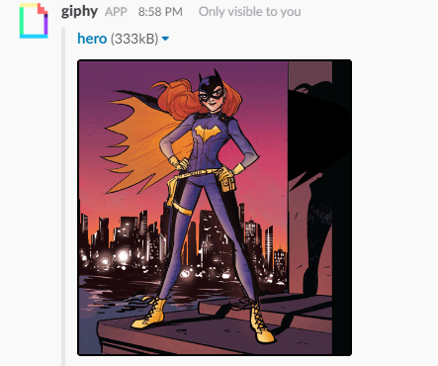
Be a hero – review code

Slide 40
Resources
https://leetcode.com/articles/longest-substring-without-repeating-characters/

Slide 41
Homework Problem
3Sum
Given an array S of n integers, are there elements a, b, c in S such that a + b + c = 0? Find all unique triplets in the array which gives the sum of zero.
Note: The solution set must not contain duplicate triplets.
For example, given array S = [-1, 0, 1, 2, -1, -4],
A solution set is:
[ [-1, 0, 1], [-1, -1, 2] ]

